Slide 1
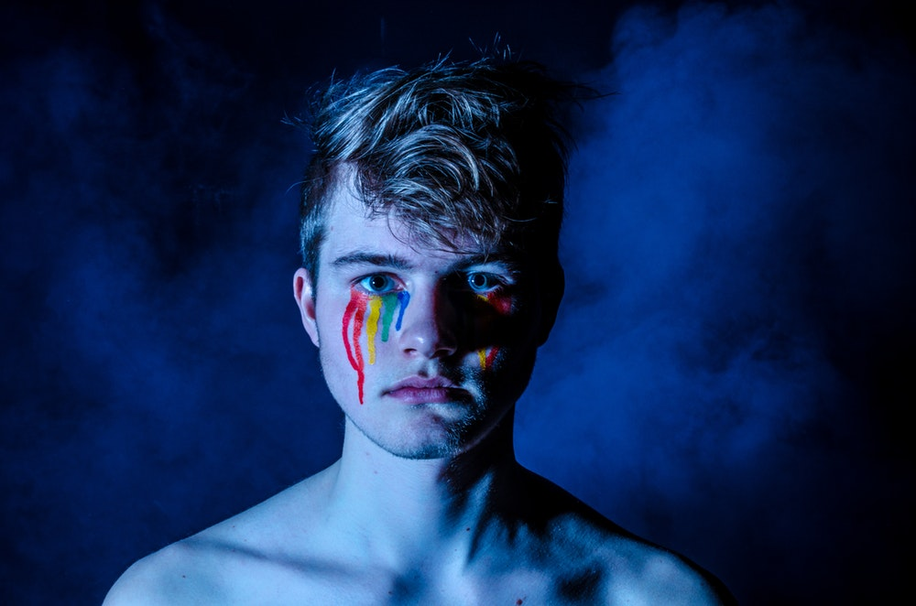









South Yorkshire LGBT+ Domestic Abuse Conference
www.sayit.org.uk/callitout
#CallItOut19

Slide 2

Introduction
Steve Slack
CEO
SAYiT
#CallItOut19
www.sayit.org.uk/callitout

Slide 3
Working Agreement
Listen well to each other
Respect each other (even if you do not respect what the person is saying)
It is fine to disagree and challenge – do this with respect and without putting other people down
There is no such thing as a ‘silly’ question – it’s OK to ask
Take care of yourself and others
Ask for anything you need
#CallItOut19
www.sayit.org.uk/callitout

Slide 4
“I wish I’d know about them (Galop) before. I recently left a nine year abusive relationship and I never accessed any services because I didn’t know there was anything for (gay/bi) men.”
“Domestic abuse services always show the same images, the crying woman cowering away from the man with the clenched fist. Why would we think the services are for us when we’re not shown in their images? We need to be represented.”
“Years ago, pre-transition I was in an abusive relationship with a woman. I called the domestic abuse helpline and they told me that they didn’t work with male abusers. When I told them that I was the victim, they didn’t believe me.”
“Services need to be more supportive of male victims. We are told growing up that masculinity = strength. As a victim of domestic violence it is also felt as an attack on our masculinity, that we are weak and that is not what a man should be. Services need to recognise that and how much it has taken for us to contact them. We need to be supported and not be made to feel weak of liars.”
“I have recently had to report hate crime to South Yorkshire Police – They just don’t seem interested. I’ve struggled to get them to take me seriously or do anything. Why would I expect anything different if I reported anything else – like domestic abuse.”
#CallItOut19
www.sayit.org.uk/callitout

Slide 5

Welcome
Prof Deborah Murdoch-Eaton
Dean of Medical Education
University of Sheffield
#CallItOut19
www.sayit.org.uk/callitout

Slide 6

Welcome
Alan Billings
South Yorkshire Police and Crime Commissioner
#CallItOut19
www.sayit.org.uk/callitout

Slide 7
Welcome
Dawn Dale
Councillor
Sheffield City Council
#CallItOut19
www.sayit.org.uk/callitout

Slide 8
Welcome
Alison Higgins
Strategic Commissioning Manager
Sheffield DACT
#CallItOut19
www.sayit.org.uk/callitout

Slide 9

Session 1: Keynote Presentations
Catherine Donovan
Durham University
#CallItOut19
www.sayit.org.uk/callitout

Slide 10

‘Raising awareness about DVA in the relationships of LGB and/or T+ people’
Catherine Donovan, University of Sunderland catherine.donovan@durham.ac.uk
with Rebecca Barnes, University of Leicester rb358@le.ac.uk
#CallItOut19
www.sayit.org.uk/callitout

Slide 11
Terms used in the presentation
Lesbian, gay, bisexual and/or trans people – LGB and/or T+
Intimate Partner Violence (IPV)– any violence/abusive behaviours that take place between adults in a (ex)relationship
Many kinds of IPV: context, impact, motives, meanings are crucial for appropriate responses
DVA – Home Office definition: pattern of behaviours (physical, sexual, emotional, financial) and coercive control
  One partner exerts power and control over the other
#CallItOut19
www.sayit.org.uk/callitout

Slide 12
Overview of presentation
The problem of DVA in relationships of LGB and/or T+ people
The problems facing victim/survivors who are LGB and/or T+ in seeking help:
  The public story of DVA
  The assumption of mutual abuse in ‘same-sex’ relationships
  What does a ‘victim’ look like/ how do they behave?
Exploring why DVA might not be recognised: a case study
What needs to be done? Some suggestions
#CallItOut19
www.sayit.org.uk/callitout

Slide 13
Prevalence of Intimate partner violence (IPV)
Heterosexual women largest group reporting IPV (Walby and Towers 2018)
  Proportionately: LGB women more likely to report partner abuse/ sexual violence than heterosexual women (ONS, 2018)
    bisexual women twice as likely to report partner abuse (10.9%) than heterosexual women (6%),
    lesbian/gay women also more likely to report than heterosexual women (8%).
    bisexual women 5x times more likely to report sexual assault than heterosexual women (1.9% and 0.4% respectively)
    lesbian/gay women also more likely to report than heterosexual women (0.5%).
#CallItOut19
www.sayit.org.uk/callitout

Slide 14
Formal help providers
Police in Greater Manchester
775 LGBT DVA cases reported to the police
  Population of GM = 2,799,000 in 2017
  7% estimate of total as LGBT = 195,930
  Proportion reporting = 0.4%
  Reporting to the police low unless: fear increases or escalation in (physical) violence (Donovan and Hester, 2008)
MARACs LGBT referrals = less than 1% nationally (Safe Lives)
#CallItOut19
www.sayit.org.uk/callitout

Slide 15
Barriers to Recognition: the public story of DVA
Feminism’s success transforming DVA from a private problem (‘a domestic’) into a serious public problem
Unintended consequences of feminist success is the public story about domestic violence /abuse (DVA)
  A problem of (cisgender) heterosexual men for (cisgender) heterosexual women
  It is a problem of physical violence / incident based
  It is a problem of particular presentation of gender: bigger, ‘stronger’ man victimising the smaller ,‘weaker’ woman
#CallItOut19
www.sayit.org.uk/callitout

Slide 16
Myths leading from public story of DVA
DVA between women (or men) is not as harmful/ risky
  women can’t be violent,
  men can’t be victimised
Physical violence between two women or two men is ‘a fair fight’ a cat fight
Violence between men is expected: naturally aggressive/ competitive
Violence between women or men is often assumed to be mutual abuse
Practitioners often feel uncertain about ‘who is the victim?’ in a relationship between two women or two men; and even more so when trans partners are involved.
#CallItOut19
www.sayit.org.uk/callitout

Slide 17
Why is mutual abuse assumed?
Public story is so powerful: if a heterosexual couple is not involved how can we identify the victim/perpetrator?
Power in intimate relationships assumed to rest on a heterosexually gendered axis:
If two women or two men are in the relationship then power can be assumed to be ‘equal’/ ‘the same’
#CallItOut19
www.sayit.org.uk/callitout

Slide 18
Constructing ‘ideal’ victims
Christie (1986) talks about the ideal victim being:
  The elderly woman who is mugged on her way back from doing her weekly shop
  Blameless
  Defenceless
  Feminised
Victims do not fight back
  They do not use violence, retaliate, take revenge
Nothing in their behaviours or demeanour can be implicated in their victimisation
They are passive, weak, overpowered mentally and physically
#CallItOut19
www.sayit.org.uk/callitout

Slide 19
Feminist scholarship tells us
DVA is about power and control: one partner using whatever violent/abusive behaviours that work to control and/or punish the other partner
Wilcox (1996), Johnson (2008) and Stark (2007) indicate that:
  Victimised partners do fight back
  Do seek help
  Do resist/ retaliate, defend themselves, children, property, relatives, friends
Many of those victimised by DVA do not see themselves in the ‘ideal victim’
Most DVA does not conform to the public’s ideas about crisis and emergency, immediate danger: typically it is chronic, low-level (Hodes and Mennicke 2019) hidden in plain sight.
#CallItOut19
www.sayit.org.uk/callitout

Slide 20
The COHSAR Project (Donovan and Hester, 2006, 2008, 2010, 2011a+b 2014)
DVA relationships are characterised by two relationship rules:
  The relationship is for the abusive partner: it’s on their terms, they make all key decisions
  The victimised partner is responsible: for the partner (and their behaviour), the relationship, the children, the household.
Practices of love act to protect the abusive partner: they rely on this and provide reasons for why they are not to blame for their behaviour (they show need/neediness)
The victimised partner feels responsible for their partner, wants to protect them, wants to believe their promises to change (they feel like the stronger partner emotionally)
#CallItOut19
www.sayit.org.uk/callitout

Slide 21
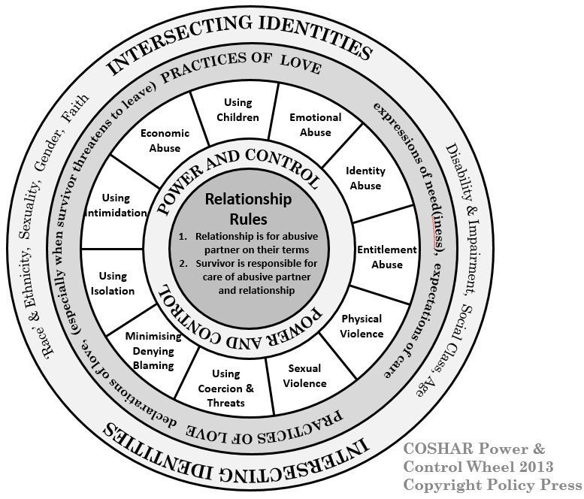
#CallItOut19
www.sayit.org.uk/callitout

Slide 22
Coercive Control in a same-sex relationship
Clare is a bisexual, cisgender, white woman who was in a relationship for six years with her lesbian partner.
It was not ok to identify as a bisexual (identity abuse)
Clare moved into her partner’s house and paid her contribution in cash. Her partner did not believe in banks.
Her partner did not believe in being visible to the authorities so Clare was expected to live outside the law which she found difficult (she lost her vote)
Her partner became very jealous of her ex-lovers, friends, and colleagues at work until Clare stopped seeing people – it wasn’t worth it
#CallItOut19
www.sayit.org.uk/callitout

Slide 23
“In my six year relationship…I saw a really scary change in me. I’m a very gentle person, … but…after the first year I found myself getting really aggressive…I sort of went into the relationship wanting to discuss things…but very quickly she got very, very insecure about sort of past, immediate, informal relationships that I was having or had. …so things like works dos, one of the past relationships was with somebody at work, so any work do I went to, …within half an hour I’d just be receiving texts, ‘So they’re there? I bet they are (freaked out noise)’ and in the end… I’d go home. Um and then I just stopped going out so I was quite submissive I guess in that sense and that really annoyed me.”
#CallItOut19
www.sayit.org.uk/callitout

Slide 24
Non-violent resistance
Clare attempted to redress the increasing imbalance in the relationship
Emma presented as butch in her manner and dress and Clare felt pressured to present as more feminine which she observed meant that she should be more submissive.
Many of Emma’s friends also presented in butch/femme couples and Clare felt pressure to ‘match’ the behaviours that these friends enacted in their relationships with Emma. However, Clare explained that this had the opposite effect on her:
#CallItOut19
www.sayit.org.uk/callitout

Slide 25
“it had kind of the opposite effect on me actually because, because you’ve got this control situation going on I felt that becoming more femme was being submissive and … you’re kind of buying into this whole kind of ‘okay honey yeah I’ll let you pay for that’ and ‘I’ll just keep quiet over here while you go and talk about bikes and stuff’, ‘I’ll make the tea’. … I didn’t want to do that. I sort of wanted to feel like I was on an equal footing which [led to] the change in the way I was dressing myself and trying to find that piece in me that maybe was a little bit more masculine. … in this kind of small town with this group of lesbians … god, never declare that you’re bisexual, do you know what I mean (short laugh). Just keep that one to yourself so to feel part of that I felt I needed to butch up rather than femme up yeah.”
#CallItOut19
www.sayit.org.uk/callitout

Slide 26
Coercive control: hidden in plain sight
Clare does not ‘fit’ the public story about DVA, coercive control, nor the ideal victim.
  She doesn’t think this was DVA though agrees that her partner was controlling
She explains that within the first two years felt a change in herself – she became ‘aggressive’, resentful.
Rather than being the gentle person she typically was, she found herself responding to her partner by ‘getting on the ladder’ of escalation in shouting matches:
#CallItOut19
www.sayit.org.uk/callitout

Slide 27
“and further into the relationship…a few arguments we’d had…actually turned physical…once she’d sort of, it wasn’t necessarily a punch, it was like a slow push with a fist that sent me to the floor um and I…remember getting up just thinking, …‘right that’s it, don’t go back’
#CallItOut19
www.sayit.org.uk/callitout

Slide 28
“[S]he’d follow me round the house, she was like… It’s like a nipping, it wasn’t shouting, it was accusative just digging, almost like verbal pokes... And so I remember getting really frustrated and, …ended up in me turning round and just saying … ‘Look I’ve had enough, you know, I’ve really had enough of this’ and…she pushed me in the shoulders, turned around and walked off…and I, I sort of shoved her in the back. ‘You don’t walk away from me, I’m talking to you’, shove. She fell and came this close to smacking her head on the loo and, ...it was that that really (clicks fingers) sort of hit home that something had to stop, something had to change. I guess up until then I just thought I could, could absorb it (Clare)
#CallItOut19
www.sayit.org.uk/callitout

Slide 29
Violent Resistance
Clare provides an account of her use of physical violence against her partner Emma: violent resistance
She does not present as a ‘victim’ i.e.
  She is not cowed
  She talks about becoming increasingly aggressive
  She talks about resisting the attempts to ‘femme’ her up – both in dress and in behaviour
What are the impacts on her?
#CallItOut19
www.sayit.org.uk/callitout

Slide 30
I think that relationship has taught me … the possibility of the way, if you allow it, somebody else can really kind of drag you down whether it’s emotionally, physically. I, I mean physically my weight went up to I think it was about eighteen stone at one point. I just completely lost my sense of self-respect I think, you know? ... I remember looking in the mirror, so this would have been probably about four and a half, five years into the relationship, and, and just not recognising who was looking back at me. Like I say like my hair was shorter, I, I’d gained four stone and yeah I, I was dressing in clothes that I’d never have dreamt of dressing in. (Clare)
#CallItOut19
www.sayit.org.uk/callitout

Slide 31
Coercive control
Emma is controlling, abusive and prepared to use violence – possible escalation
Use of jealousy to explain controlling behaviours ‘typical’
  Neediness of abusive people – contradicts public story of ‘strength’
Range of abusive behaviours: emotional, financial – and, rarely, physical
Coercive control
Impacts on Clare are substantial and building over time
In this relationship coercive control reflect relationship binary mirroring dominant heteronormative gendered ideas
  Also relies on jealousy
#CallItOut19
www.sayit.org.uk/callitout

Slide 32
Conclusions
Recognition of DVA can be prevented by:
  The public story of DVA
  The public story about victim/perpetrator
Specialist DVA services are not identified as potential sources of support by LGB and/or T+ people
Police are not identified as source of help
Counsellors and Therapists in private and public health settings/ third sector settings are important providers of formal support for those experiencing in DVA in relationships where at least one partner is LGB and/or T
#CallItOut19
www.sayit.org.uk/callitout

Slide 33
How to encourage help-seeking: LGB and/or T networks, communities, scene
Make the story about DVA more inclusive: this can happen in the relationships of LGB and/or T+ people.
Use the COHSAR wheel to start conversations/discussions about what coercively controlling relationships look like
  Recognise that there are different forms of violent behaviours – self-defence, retaliation, protective, punitive, controlling
  Recognise the power dynamics through the relationship rules
Understand and address fears of LGB and/or T+ people about reporting to mainstream agencies:
  having their sexuality/gender identity problematised
  confidentiality,
  being respected,
  not being incorrectly identified as the perpetrator,
  not being incorrectly identified as a co-perpetrator.
#CallItOut19
www.sayit.org.uk/callitout

Slide 34
How to provide Inclusive services
Have trained, confident practitioners who can see past the public story of DVA and focus on how power is operating in the relationship as a whole
Understand particular ways that identity abuse can be used to control LGB and/or T people
Use the COHSAR Wheel to identify the range of behaviours an abusive partner might use to assert:
  Power and control through
  Relationship rules
#CallItOut19
www.sayit.org.uk/callitout

Slide 35
Inclusive services continued
Explicit mention of LGB and/or T+ people in literature, flyers, website, posters
Partnership working with local LGBT organisations
Awareness of specialist LGBT DVA organisations – for support and advice; and training
#CallItOut19
www.sayit.org.uk/callitout

Slide 36
Session 1: Keynote Presentations
Michaela Rogers
University of Sheffield
#CallItOut19
www.sayit.org.uk/callitout

Slide 37
Trans and non-binary people, domestic violence and abuse (DVA) and cisgenderism
Dr Michaela Rogers
#CallItOut19
www.sayit.org.uk/callitout
Notes:
Hello
I’m Michaela Rogers, SL in Social Work here at the University.

Slide 38
My research
PhD Social Work - TransForming Practice: Trans people’s experiences of domestic abuse and social care agencies. Interviews with 15 people who identified as trans and had experienced family violence or intimate partner violence and 9 practitioners working in fields such as a refuge, DVA forum and young women’s housing project
Change Up LGBTQ+ Pilot: evaluation of a programme designed to raise awareness of DVA and promote healthy relationships delivered in LGBT youth clubs.
DVA Service, LGBT Foundation: evaluation using one-to-one interviews of service users.
#CallItOut19
www.sayit.org.uk/callitout
Notes:
I’ve been invited here to talk about some of my work around domestic violence and abuse and LGBT communities. I’ve selected a particular aspect of my work which I’ve been developing over the last few years which I’ll come on to. First, I’ll summarise my work to date. In 2013 I finished my PhD here at the University which explored trans people experiences of DVA and their social care needs.
More latterly, I’ve been working with different agencies in Greater Manchester evaluating different programmes of support and awareness raising and recently completed a evaluation of the pilot described here which resulted in me spending time with LGBTQ young people and talking about healthy relationships and the ongoing need to raise awareness of DVA in all its forms.

Slide 39
Identity terms
Trans – umbrella term describing a person whose self-identification in relation to gender is different to that which was assigned at birth including; trans male, trans female, transsexual woman, transsexual man, MtF, FtM, a woman or man with a transgender history.
Non-binary – umbrella terms incorporating genderqueer, genderfluid, agender, bi-gender, pangender and other identities that describe a person whose gender does not conform with the male/female binary.
Cisgender (or cis) – describes a person whose experience of gender identity remains aligned to that which was assigned at birth.
#CallItOut19
www.sayit.org.uk/callitout

Slide 40
Cisgenderism
Gender normativity – promotes ideas about cisgender identities as natural and fixed, as well as heterosexual marriage and procreation between a cisgender man and a cisgender woman as the norm.
Gender normativity - binary gender is the norm, any deviation from this as abnormal. Subsequently, people are judged and accepted on whether they do or do not comply
Prejudicial ideology: operates on multiple levels: eg it is both individual and structural
Cisgenderism therefore marginalises and delegitimises people’s self-identification in terms of gender and self-designation of the body as one thing or another.
It is important to bear in mind that cisgenderism can be both intentional or unintentional (Ansara & Hegarty, 2011, 2014).
#CallItOut19
www.sayit.org.uk/callitout
Notes:
The work that I’ve been developing over the last few years is build on this concept of cisgenderism.
Cisgenderism is a concept built on ideas about gender normativity… which promote beliefs and norms about cisgender identities as natural and fixed as well as promoting ideas about heterosexual marriage and procreation between a cis man and a cis woman as the norm.
Anyone who identifies outside of this paradigm is seen as abnormal or deviant in some way.
Cisgenderism is a prejudicial ideology similar to Sexism and Racism and, as such, it operates at the level of the individual and structural eg ideas about gender normativity are built into laws, policies and underpin social institutions such as the family, religion, and education.
Therefore cisgenderism marginalises people who identify outside of the norm as trans or non-binary

Slide 41
Cisgenderism
Cisgenderism is multi-dimensional. Examples:
  Misgendering refers to the specious use of gendered language which does not reflect how a person self-identifies (Ansara & Hegarty, 2014). Examples of misgendering: using a person’s previous name or gender pronoun which does not accurately convey their self-designated gender. Misgendering also occurs at a structural level when, for example, a system, structure or norm (social, medical, economic or legal) does not recognise a person’s self-identification.
    For example, in the UK someone may identify as male or female but unless they have a Gender Recognition Certificate (applied for under the Gender Recognition Act 2004), they cannot apply for a replacement birth certificate in their self-identified gender.
#CallItOut19
www.sayit.org.uk/callitout
Notes:
But cant get a birth certificate is non binary – we don’t have a legal recognised gender other than male or female

Slide 42
Cisgenderism
Cisgenderism is multi-dimensional. Examples:
  Pathologising refers to the intentional action of labelling and treatment of people’s self-identified gender, body, presentation and expression as abnormal or deviant (Ansara & Hegarty, 2014).
#CallItOut19
www.sayit.org.uk/callitout

Slide 43
Cisgenderism: misgendering
Jim (30 years old, trans man) described his ex-partner, Emma’s behaviour:
‘She’d talk about me to others and say “have you heard what “Paula” is claiming? SHE’s saying SHE’s identifying as a man now”. Emma refused to call me Jim.’
#CallItOut19
www.sayit.org.uk/callitout
Notes:
Jim (30 years old, trans man) experienced misgendering from his ex-partner, Emma. after he disclosed his trans status. Emma actively denied Jim’s male identity as she said “it’s shit. I don’t believe you.” Jim and Emma had previously been in a lesbian relationship. They separated seven months after Jim came out as trans. Throughout those seven months Emma misgendered Jim directly in their daily interactions
As show in this QUOTE

Slide 44
Cisgenderism: misgendering
Similarly, the behaviour of Caroline’s (63 years old, woman with a transsexual history) brother was overtly active, as opposed to passive, as illustrated in the following excerpt:
‘I’ve a brother who doesn’t acknowledge me. Well, he acknowledges me in the fact that we exchange cards […] That’s the one bad thing that’s happened in my life […] they buy predominantly male oriented birthday cards, Christmas cards with pint pots and footballers on and that.’
#CallItOut19
www.sayit.org.uk/callitout

Slide 45
Cisgenderism: pathologising
When Max (25 years old, trans/femme male) disclosed his trans status to his then partner, Su, she responded in a negative way. Su drew parallels with male bodies as representing a violent threat to women’s safety and wellbeing. Max explained:
‘My partner at the time was honest with me about the fact that she doesn’t feel as safe around men or around ‘male’ bodies, and that she may no longer feel safe around me as my physical transition progressed.’
#CallItOut19
www.sayit.org.uk/callitout
Notes:
Max’s experiences of pathologizing were plentiful with some ex-partners exploiting on his insecurity around his physique which he described as “small and femme” and Max admitted that “I struggle to not compare my body in an unfavourable way to the bodies of cis men”.
When Max disclosed his trans status to his then partner, Su, she responded in a negative and unsupportive way. Su drew parallels with male bodies as representing a violent threat to women’s safety and wellbeing. Max explained:
BUT Max said that he was far from presenting as typically male at the time.

Slide 46
Cisgenderism: pathologising
Ally’s (27, trans male) narrative offers examples of a family’s response to someone who has been diagnosed with gender identity disorder:
‘Lots of emotional abuse seeped out when I came out to my parents as trans […] My dad of course made it sound like I would be a shame to all of my [Asian] family, and all of his friends. My mom told me she knew I was "gender confused" but thought I would grow out of it, and suggested that I go for restorative therapy.’
#CallItOut19
www.sayit.org.uk/callitout
Notes:
Max’s experiences of pathologizing were plentiful with some ex-partners exploiting on his insecurity around his physique which he described as “small and femme” and Max admitted that “I struggle to not compare my body in an unfavourable way to the bodies of cis men”.
When Max disclosed his trans status to his then partner, Su, she responded in a negative and unsupportive way. Su drew parallels with male bodies as representing a violent threat to women’s safety and wellbeing. Max explained:
BUT Max said that he was far from presenting as typically male at the time.

Slide 47

Summary: Cisgenderism
#CallItOut19
www.sayit.org.uk/callitout
Notes:
This has been a whistle stop tour of cisgenderism and I’m sure you won’t remember the detail of what I’ve talked about but I’m hoping that you remember that
cisgenderism is a prejudicial ideology, similar to sexism and racism
it underpins experiences for many trans people in their personal and family relationships, and in daily life more generally and
it has significant detrimental impacts.
THANK YOU

Slide 48

Q & A
#CallItOut19
www.sayit.org.uk/callitout

Slide 49

Break
#CallItOut19
www.sayit.org.uk/callitout

Slide 50
Session 2: Keynote Presentations
Gill Valentine
Provost and Deputy Vice Chancellor
University of Sheffield
#CallItOut19
www.sayit.org.uk/callitout

Slide 51

Session 2: Keynote Presentations
Jasna Magic
Galop
#CallItOut19
www.sayit.org.uk/callitout

Slide 52

Recognise & Respond:
Strengthening advocacy for LGBT survivors of domestic abuse
JASNA@GALOP.ORG.UK
#CallItOut19
www.sayit.org.uk/callitout

Slide 53

KEY POINTS
National report
Stats
Nature and tactics of abuse
Barriers in access to services
Key trends in access to services
LGBT+ specialist service provision
#CallItOut19
www.sayit.org.uk/callitout

Slide 54
KEY POINTS
Aims
To support services to improve their understanding of LGBT+ people’s experience of domestic abuse, tailor their provision and ensure their programs remain inclusive for all those who identify as LGBT+.
Data collection
Literature review (over 50 UK based resources)
A series of interviews, and meetings with LGBT+ domestic abuse advocates and experts
LGBT+ service user datasets (7 LGBT+ specialist services)
Joint Submission to Government Consultation on the proposed Domestic Abuse Bill (unpublished)
The LGBT+ thematic event, supporting the consultation on Domestic Abuse Bill
National LGBT+ Domestic Abuse Network meeting
#CallItOut19
www.sayit.org.uk/callitout

Slide 55
STATS / PREVALENCE
LGB survivors:
GEO study (2018) - 29% of all LGBT+ respondents disclosed an incident involving someone they lived with because they identified as LGBT+
Stonewall study (2011) - 49% of all gay/bi men disclosed at least one incident of domestic abuse from a family member or partner since the age of 16.
Stonewall study (2008) - 25% of lesbian and bi women disclosed domestic abuse from a current partner.
Trans survivors:
Stonewall study (2018) - 28% of all trans respondents disclosed intimate partner violence a year prior to study taking place.
STA study (2010) 80% of trans respondents disclosed emotionally, sexually, or physically abusive behaviour by a partner or ex-partner.
#CallItOut19
www.sayit.org.uk/callitout

Slide 56
Nature/ tactics of abuse
LGBT+ survivors share similar forms of domestic abuse as their heterosexual/cis peers and experience abuse from both intimate partners and family members.
LGBT+ people’s experiences and tactics of abuse are frequently linked to their sexual orientation and gender identity.
LGBT+ survivors are not a homogenous group. Experiences of abuse differ across the subgroups.
#CallItOut19
www.sayit.org.uk/callitout

Slide 57
Barriers in access to services
LGBT+ survivors face distinct systemic and personal barriers in accessing services, due to their sexual orientation and gender identity.
LGBT+ domestic abuse is vastly underreported and under-recorded
LGBT+ survivors are disproportionally underrepresented in voluntary and statutory, including criminal justice services.
#CallItOut19
www.sayit.org.uk/callitout

Slide 58
Key trends in access to services
Age:
Under 24 and those over 65 are not accessing support with the same rate as other age groups.
Under 24 are more likely to use remote services such as phone helpline.
Over 65 are more likely to experience barriers associated with health status, and disclose higher additional risks and vulnerabilities in comparison to other age groups.
Gender of survivors and perpetrators:
In most cases services supported higher numbers of male clients over other genders.
Female survivors are more likely than male clients to use remote services such as phone helpline and access mainstream/generic domestic abuse services.
LGBT+ survivors of all genders largely disclose abuse from a male perpetrator.
Male survivors mainly disclose abuse by a male perpetrator, female survivors disclose abuse by both male and female perpetrators.
#CallItOut19
www.sayit.org.uk/callitout

Slide 59
Key trends in access to services
Trans identity:
Trans survivors are significantly more likely to access LGBT+ specialist support over mainstream/generic domestic abuse service.
Trans survivors are more likely to disclose abuse by family members compared to cisgender LGBT+ survivors.
Trans survivors may be denied support due to gaps in policy, anti-trans prejudice, or they can be turned away because of their gender history.
Additional risks and vulnerabilities:
At a minimum, one in three LGBT+ survivors disclosed one form of disability.
By the time they access services, LGBT+ survivors are more likely, than their non-LGBT+ peers to present with complex and additional needs, such as mental health issues, issues related to alcohol and drugs misuse, mobility or long-term health problems such as living with HIV/AIDS.
In comparison to non-LGBT+ peers, LGBT+ survivors are twice as likely to have self-harmed, are more likely to be abused by multiple perpetrators, and disclose experiences of historical abuse by a family member.
#CallItOut19
www.sayit.org.uk/callitout

Slide 60
Key trends in access to services
Race and ethnicity:
LGBT+ BME survivors are significantly more likely to access LGBT+ specialist support over mainstream/generic domestic abuse services.
BME people are at a disproportionate risk of abuse from family members in comparison to clients with white background.
LGBT+ BME people’s experiences of reaching out to services may be compounded by intersection of racism, homophobia and transphobia.
#CallItOut19
www.sayit.org.uk/callitout

Slide 61
Recommendations
Ask about sexuality and gender identity.
Access training on how and when to ask about sexuality and gender identity
Build knowledge and capacity to meet the needs of diverse LGBT+ victims and survivors.
Apply a nuanced approach and develop support which is person-centred, recognising different and intersectional needs of survivors.
Recognise additional barriers in access to services and increase “welcome” for young and elderly LGBT+ survivors, trans survivors and those LGBT+ with a BME background.
Be clear on what support you offer.
Establish close links with relevant local services, be able to signpost and make informed referrals.
Services should also consider facilitating mutual support and other opportunities such as reciprocal training and awareness raising.
#CallItOut19
www.sayit.org.uk/callitout

Slide 62

Session 2: Keynote Presentations
James Henshall
Irwin Mitchell
#CallItOut19
www.sayit.org.uk/callitout

Slide 63
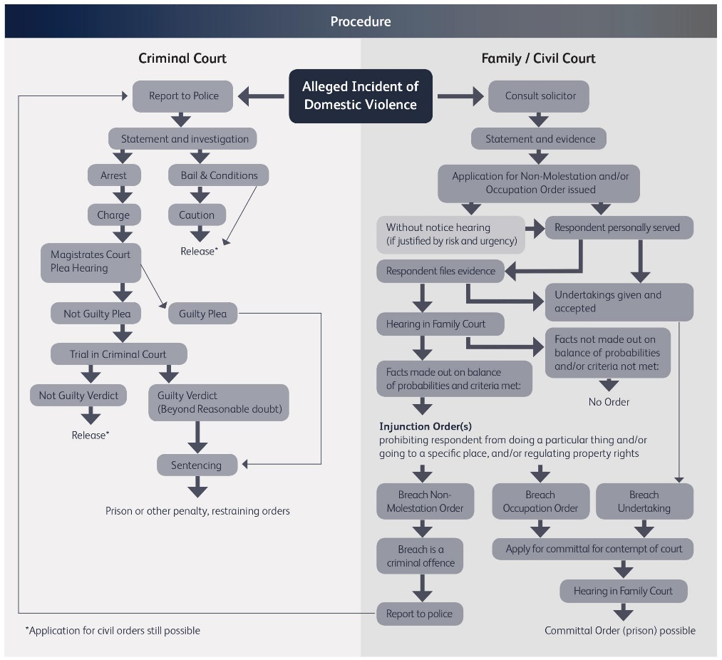
#CallItOut19
www.sayit.org.uk/callitout

Slide 64
Session 2: Keynote Presentations
Elly Sinclair and Heather Paterson
LGBT+ Domestic Abuse Development Workers
SAYiT
#CallItOut19
www.sayit.org.uk/callitout

Slide 65
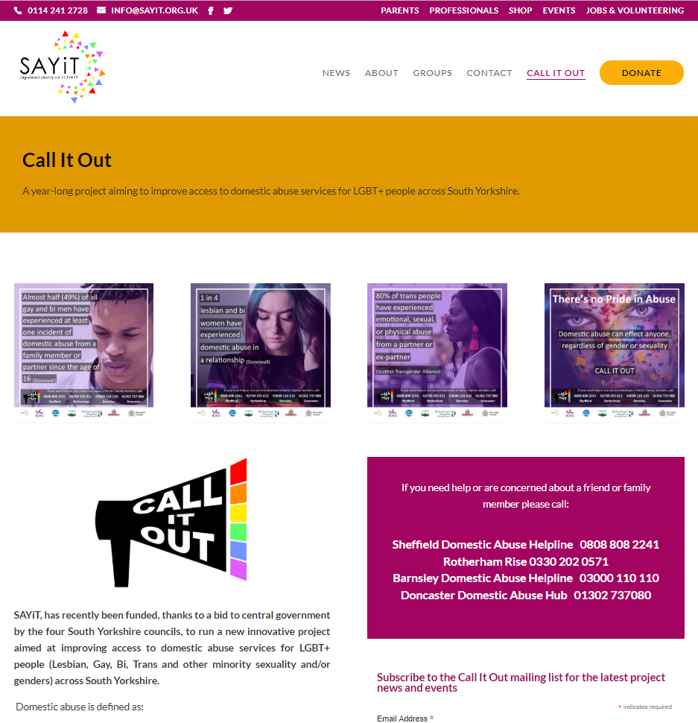
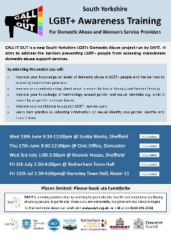
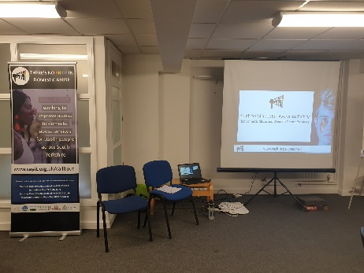
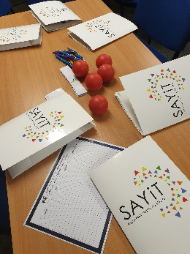

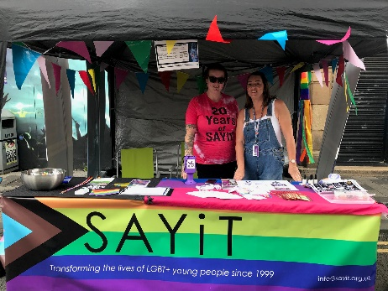
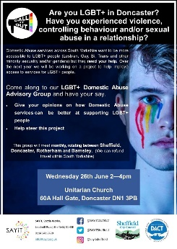
Call It Out Project: Work so far
Service Providers:
Meeting key partners / networks
LGBT+ awareness training
Webpage & resources
LGBT+ Community
Service user advisory group
Community consultations
Pride events
#CallItOut19
www.sayit.org.uk/callitout

Slide 66
Call It Out Project: Future Work
Service Providers:
LGBT+ Domestic Abuse awareness training
1 to 1 work with services to develop LGBT+ inclusion action plans
Project legacy for service providers
  Launch of LGBT+ inclusive service kitemark
  Training module on LGBT+ Domestic Abuse
LGBT+ Community
Continue capturing the stories of local LGBT+ survivors of domestic abuse
Awareness campaign – both on domestic abuse and existence of services
Project legacy for LGBT+ community
  LGBT+ Domestic Abuse Awareness Champions
#CallItOut19
www.sayit.org.uk/callitout

Slide 67
Q & A
#CallItOut19
www.sayit.org.uk/callitout

Slide 68

Service user voices
#CallItOut19
www.sayit.org.uk/callitout

Slide 69
Comfort Break
#CallItOut19
www.sayit.org.uk/callitout

Slide 70
Workshops
#CallItOut19
www.sayit.org.uk/callitout

Slide 71
Plenary and Close
#CallItOut19
www.sayit.org.uk/callitout

Slide 72


Thankyou
#CallItOut19
www.sayit.org.uk/callitout

Slide 73

Lunch and networking
#CallItOut19
www.sayit.org.uk/callitout

